Slide 1
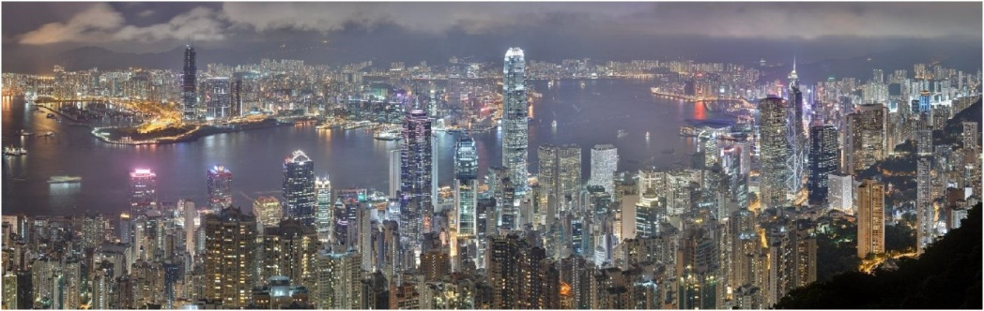
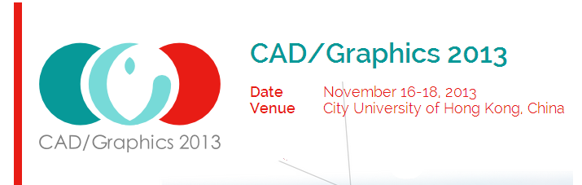





Efﬁcient 3D Reconstruction of Vessels from Multi-views of X-Ray Angiography
Xinglong Liu¹, Fei Hou¹, Aimin Hao¹, Hong Qin²
¹State Key Laboratory of Virtual Reality Technology
and Systems, Beihang University, China houfei@vrlab.buaa.edu.cn
²Stony Brook University, Stony Brook, USA
qin@cs.sunysb.edu
Notes:
Good morning, My name is Xinglong Liu, I am a PhD candidate from State Key Laboratory of Virtual Reality Technology and Systems, Beihang University, China.
I did my work with Doctor Hou, Prof. Hao and Prof. Qin from Stony Brook University.
The title of my paper is: Efﬁcient 3D Reconstruction of Vessels from Multi-views of X-Ray Angiography.

Slide 2
Presentation Overview
Motivation
Method
Experimental results
Conclusion and future work
Notes:
This is an overview of my presentation.
I will first talk about our motivation and then the method and then the experimental results, finally we will talk about the conclusion and future work.

Slide 3
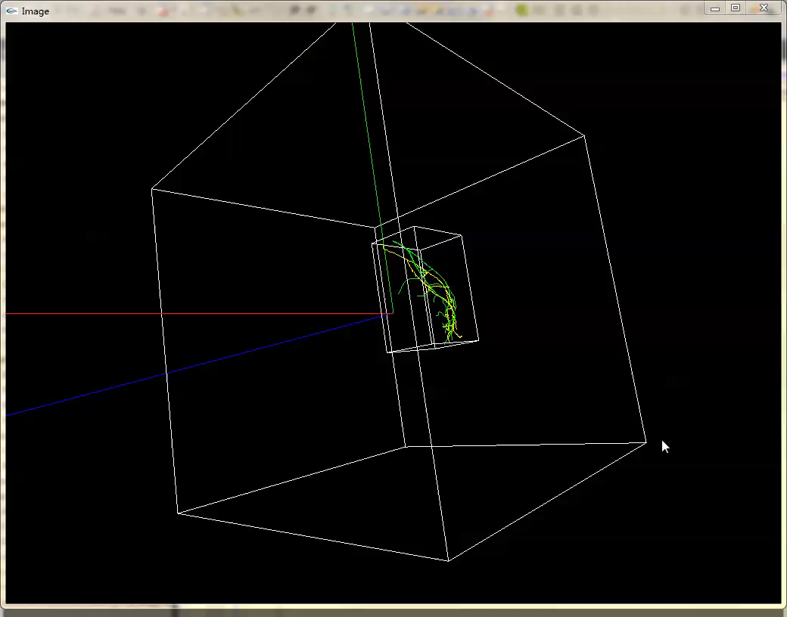
Notes:
This is a demo with reconstructed vessel skeletons. The green one in the center is the ground truth constructed by human hands.
The yellow one in the center is the reconstructed skeletons from three views of 2D skeletons. During the rotation, there are three
Views of angiograms used to reconstruct the 3D structures.
We can split the two skeletons to have a more accurate sense of the difference between them. (00:30)

Slide 4
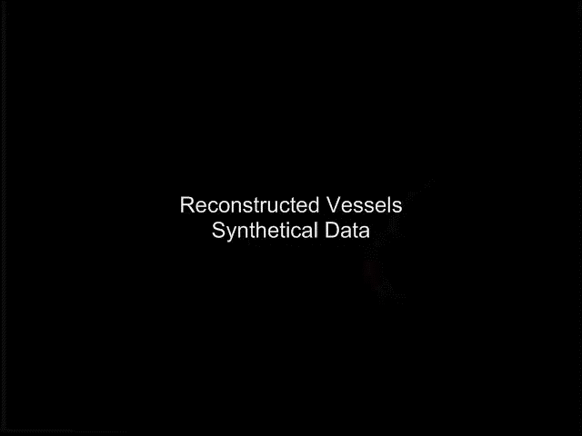
Notes:
Also, we extract the diameter data from the contour of the vessels. This demo shows the reconstructed vessels from both synthetical data and with diameters. All vessels are
Rendered as connected cylinders.

Slide 5
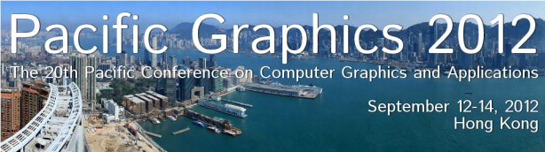
Challenges
How to avoid the shortcomings such as viewing angle dependence, magnification factor, overlapping and blurring between vessels, backgrounds and other organs.
How to avoid registration between image pairs and enforce constrains during the reconstruction.
Notes:
So, we see four challenges in the field of 3D reconstruction from 2D images.
First, there are inherent shortcomings during the imaging of X-Ray.
Then, we also wanna avoid registration as well as add constrains during the reconstruction.

Slide 6
Motivation
We develop an efﬁcient vessel reconstruction system based on multiple X-Ray views.
Accurate detailed vessel segmentation.
Combination of local features including both consistency and continuity.
Avoidance of registration between image pairs
Efficient.

Slide 7
Contributions
We divide the spaces between the X-Ray iso-center and the detector into slices in which we sample the 3D space points and project them to the image space considering consistency and continuity with their neighbors, overcoming the lack of constraints for typical registrations.
We formulate the 3D reconstruction as a global energy optimization problem and solve it by using belief propagation.

Slide 8
Presentation Overview
Motivation
Method
Experimental results
Conclusion and future work
Notes:
This is an overview of my presentation, I will begin with Introduction, and then talk about the algorithmic details, then show some experimental results, and at last, I will make a conclusion and talk about the future work.

Slide 9
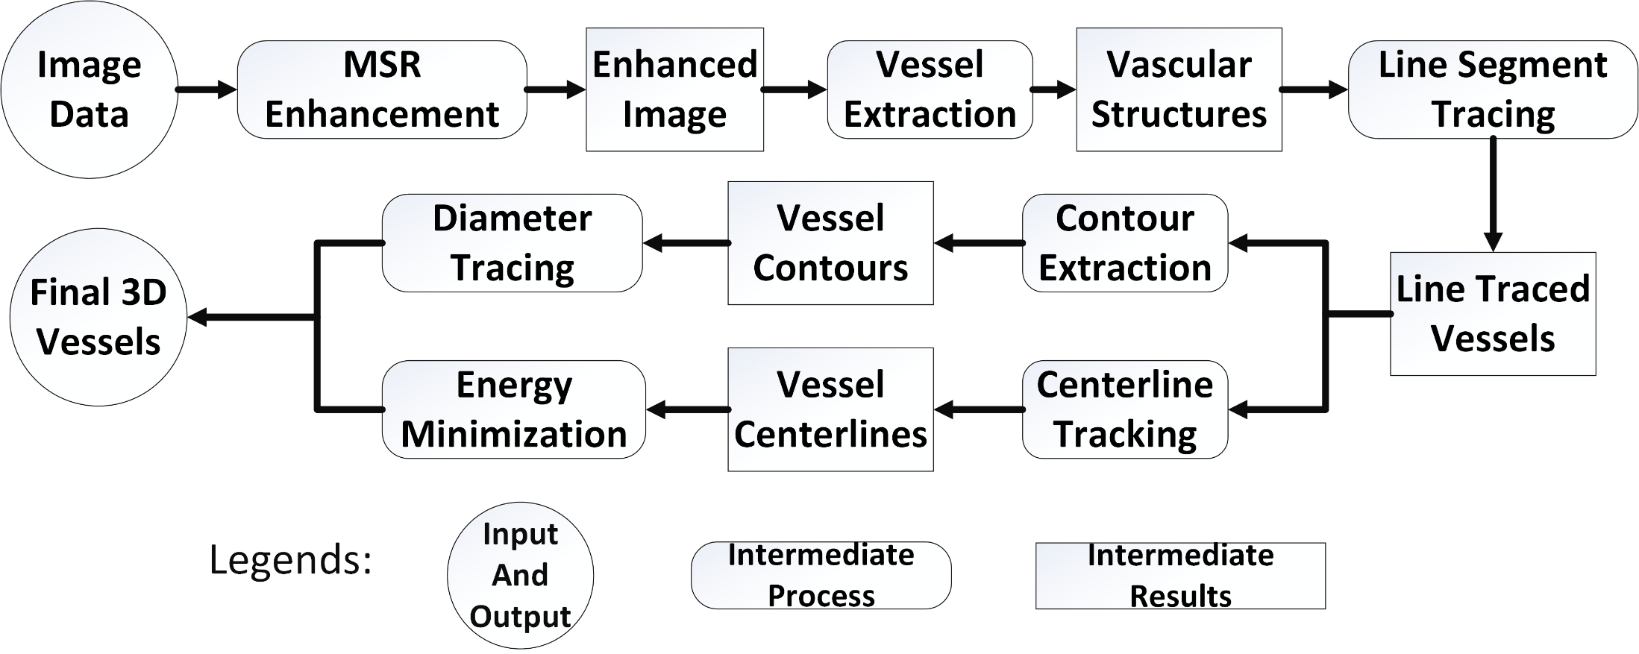
Method Overview
ROUNDED RECTANGLE
RECTANGLE
CIRCLE
Notes:
The pipeline is shown in Figure 1. First, we apply the multi-scale retinex method to enhance the
contrast of the angiogram. Second, we implement a CUDA edition of Hessian matrix based vessel ﬁlter with
hysteresis thresholding to get the preprocessing results. Third, we perform the fast-marching method
using second order derivatives and cross neighbor templates to extract the accurate centerline of the vascular-structure.
Finally, 3D reconstruction with local constraints and space consistencies is formulated as an
energy minimization problem and solved using belief propagation. All these lead to a fast reconstruction result of the data and
promise accuracy and e ﬃ ciency which can give the doctor a good sense of coronary artery 3D space structures.

Slide 10
Multiscale Retinex Image Enhancement
Purpose
Overcome shortcomings such as the low image contrast, the low lumen with the wide dynamic range.
Notes:
So, the first step is the image enhancement.

Slide 11
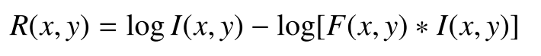
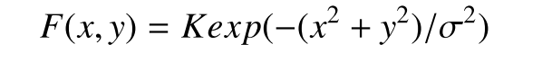
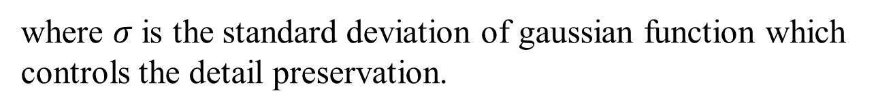
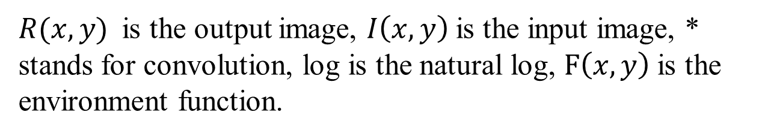
Multiscale Retinex Image Enhancement
Method
$R(x,y)$ is the output image, $I\left(x,y\right)$is the input image, * stands for convolution, log is the natural log, $F\left(x,y\right)$is the environment function.
where $σ$ is the standard deviation of gaussian function which controls the detail preservation.
Notes:
The core of the step is the convolution between the image and the environment function .

Slide 12
Vessel Extraction
Purpose
Enhance or extract the vascular structures with the avascular as less as possible.

Slide 13
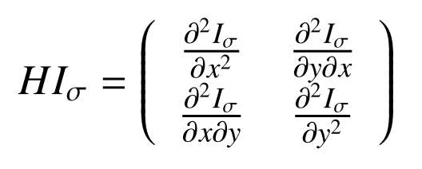
Vessel Extraction
Method
For every pixel on the image, we calculate the second-order derivatives to build the Hessian matrix H. And convolve the image with the matrix.
Notes:
Vessel extraction is also based on convolution.

Slide 14
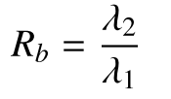
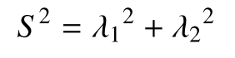
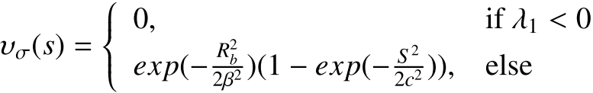
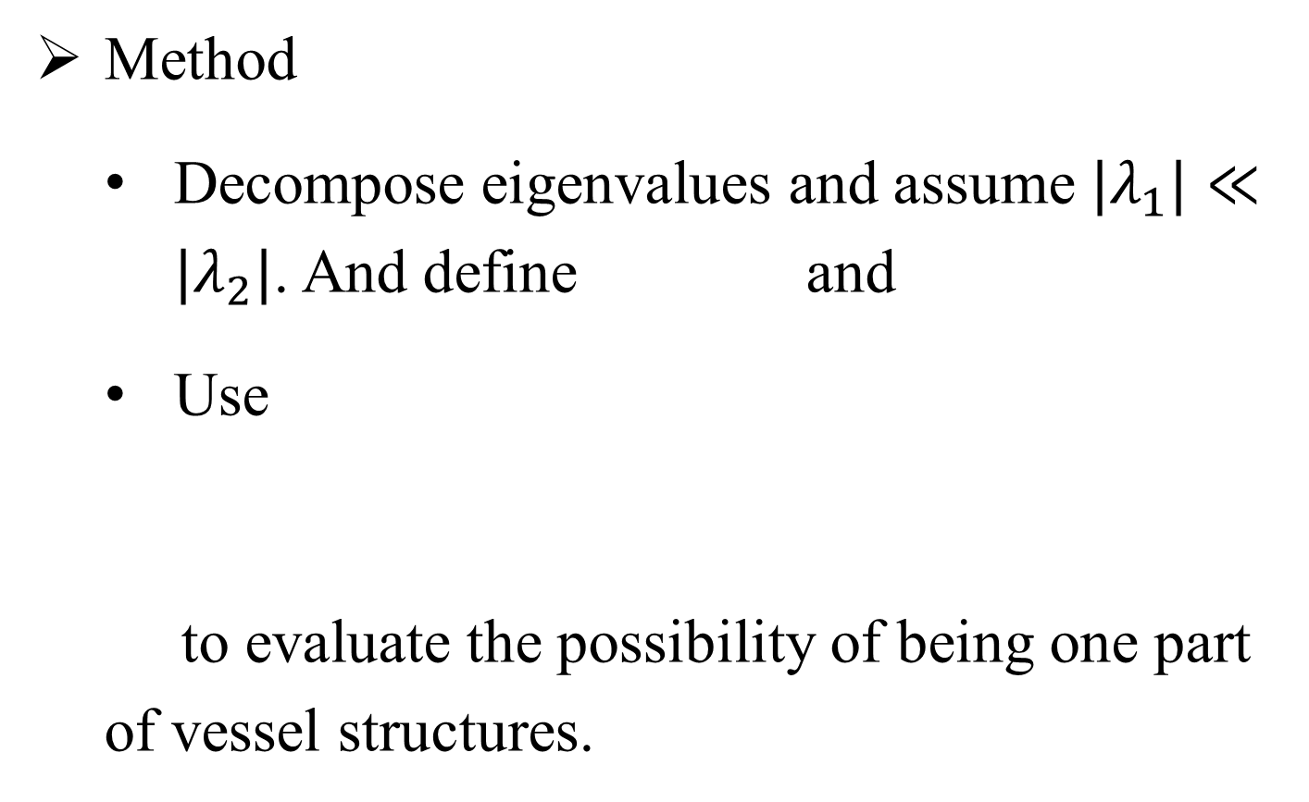
Vessel Extraction
Method
Decompose eigenvalues and assume ${|λ}_{1}|≪{|λ}_{2}|$. And define and
Use
to evaluate the possibility of being one part of vessel structures.
Notes:
We generate the proxy particles just behind the fluid particle so they are going to contact and response.

Slide 15
Centerline Tracking
Purpose
Make the vessels thinner and get the vascular skeleton.
To Apply template-based feature finding.

Slide 16
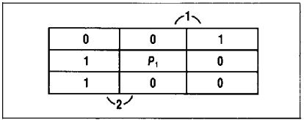
Centerline Tracking
Method
Two iteration parallel method
Based on 8-neighbours on 2D images.
Easy to be implemented on CUDA.
Notes:
We investigate the 8-neighbours of the current point.

Slide 17
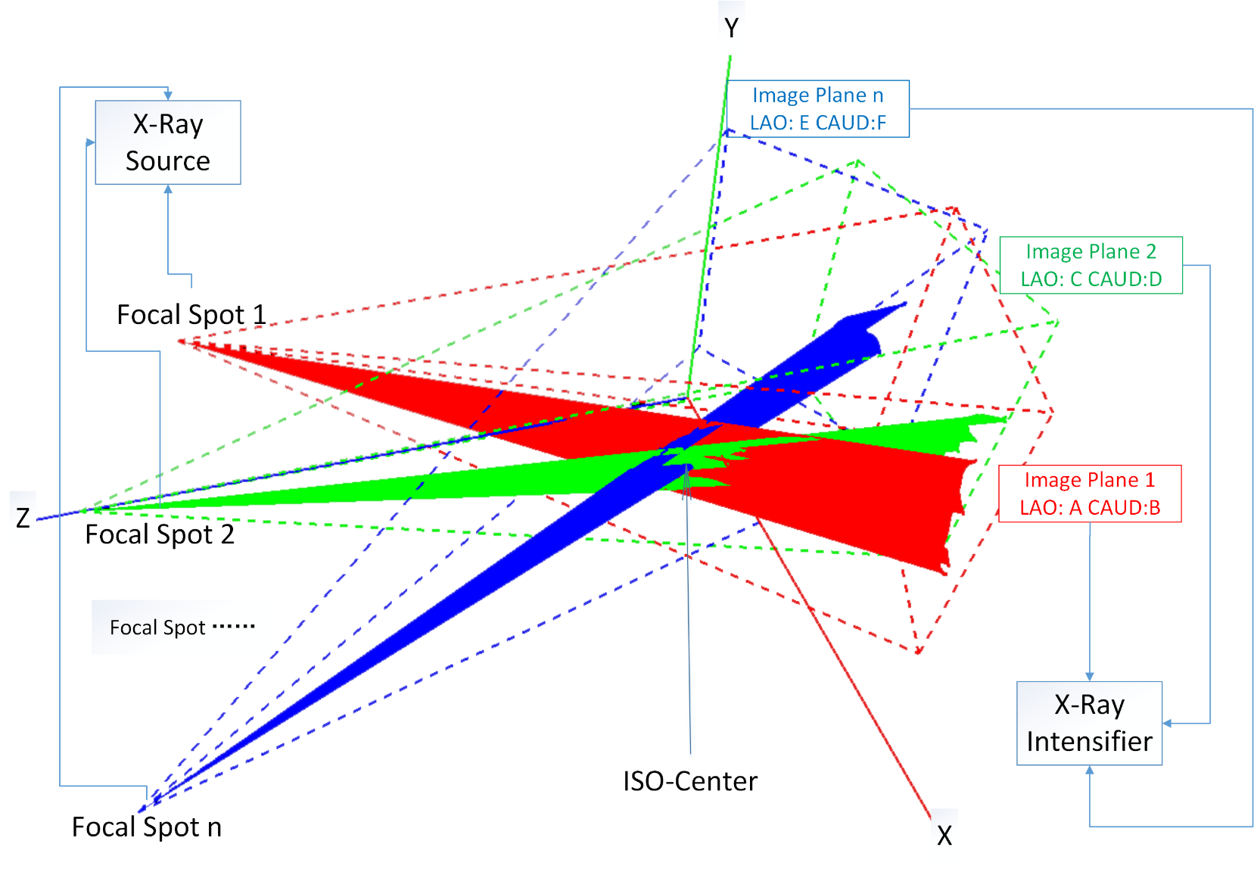
3D Reconstruction
XRay
Perspective
Projection
Notes:
The imaging modality of the X-Ray angiograms is
diﬀerent from the ways other imaging devices such as
cameras or videos work in. The light source is the
X-Ray source and the imaging plane is the intensiﬁer.
The imaging procedure is mostly like perspective projection under 3D space. We simulated this procedure using OpenGL.
The frustum of each color represents one view of the angiograms. The source of the frustum could be seen
as X-Ray source, while the far plane could be seen as the intensiﬁer. The vessel skeletons should be at the
iso-center. The exact intersected lines from every view should be 3D space structures of the skeletons of the
projected vessels. Being aware of the diameters at every skeleton point, we can get the structures of the vessels

Slide 18
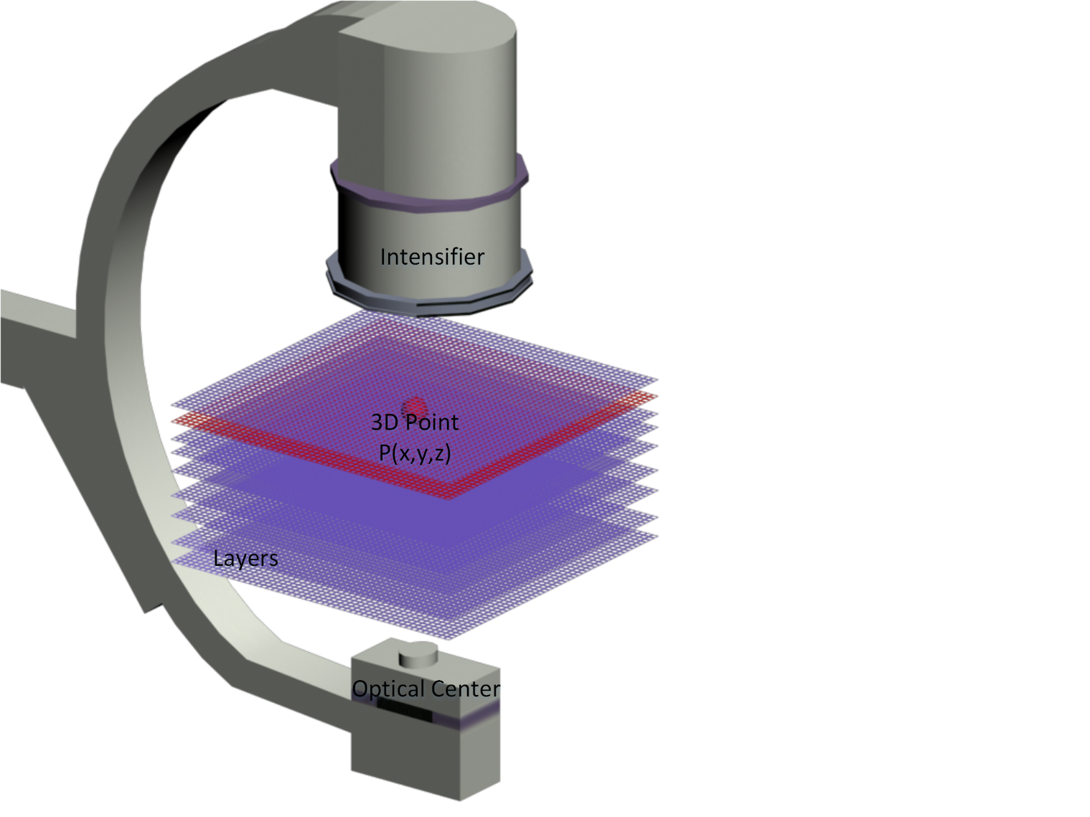
3D Reconstruction
Sketch Map Of Space Division
Notes:
In our approach, we use at least three views of angiograms at the same cardic cycle and choose the
projection view I 1 as a reference view which includes the least foreshortening and overlap among all the views.
Each depth can be assigned with a label li . Meanwhile, each skeleton point on reference view I1
corresponds one projected line from the source to the intensiﬁer through all the layers.
Therefore, for a given pixel p on I1 , the pair (p , l i ) uniquely identiﬁes a point in 3D space. So, the goal
of the 3D reconstruction is to optimally assign an label li to each p on the centerline of the reference view I1.
This problem can be formulated as an energy minimization problem considering connectivity and topological
structures.

Slide 19
3D Reconstruction
Our goal is to ﬁnd the minimum energy and we use the belief propagation (BP) method to achieve the solution.
We compute the minimum sum of all the grouped vessel skeletons’ cost, and obtain the optimal solution for the whole vessel skeleton tree. After the reconstruction of the 3D skeletons of the coronary arteries, using the diameters we extracted, we obtain the ﬁnal results.

Slide 20
Presentation Overview
Motivation
Method
Experimental results
Conclusion and future work
Notes:
This is an overview of my presentation, I will begin with Introduction, and then talk about the algorithmic details, then show some experimental results, and at last, I will make a conclusion and talk about the future work.

Slide 21
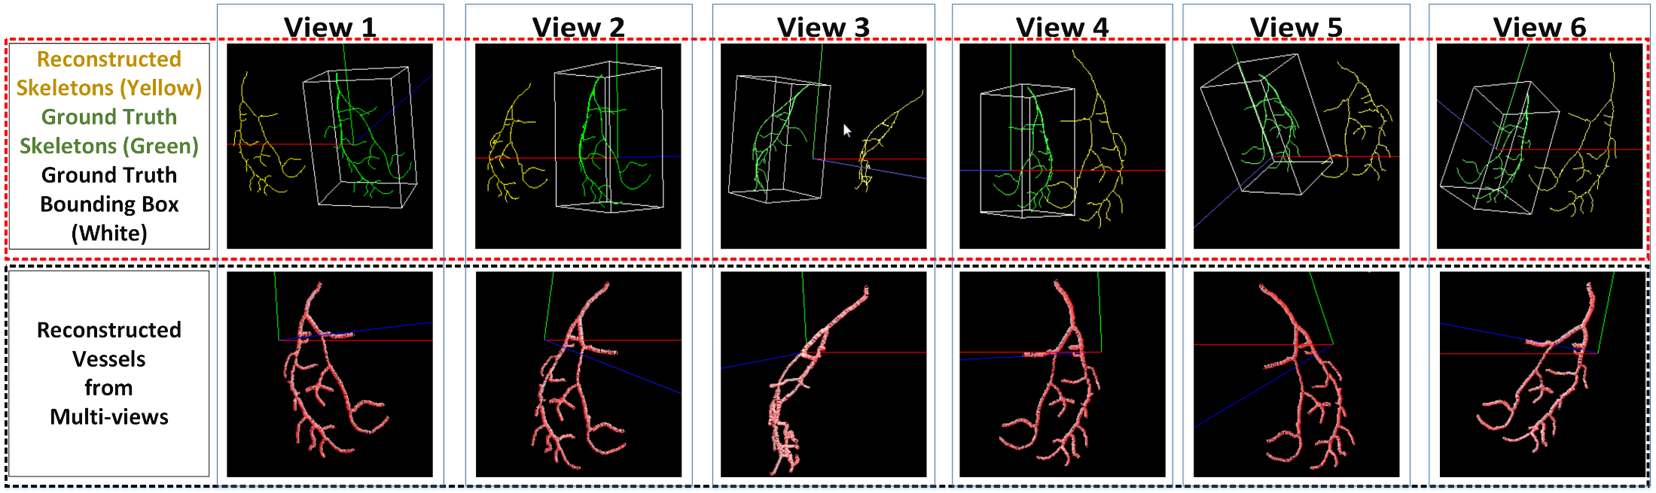
Results
Reconstructed vessels from synthetic data
Notes:
We test our reconstruction method on synthetic data and
real clinical data, respectively. Compared with real data, the
reconstruction of synthetic data is easy to assess because of
the vessel ground truth. The ﬁnal reconstruction results of
synthetic data are shown.
In the top row, the yellow lines indicate the
reconstructed skeleton using our method. The green lines
indicate the ground truth obtained in our simulation plat-
form. The white box is the bounding box of the ground
truth.

Slide 22
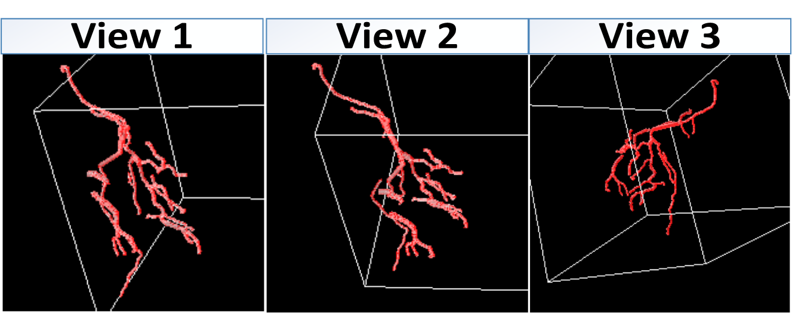
Results
Reconstructed vessels from clinical data

Slide 23
Presentation Overview
Motivation
Method
Experimental results
Conclusion and future work
Notes:
This is an overview of my presentation, I will begin with Introduction, and then talk about the algorithmic details, then show some experimental results, and at last, I will make a conclusion and talk about the future work.

Slide 24
Conclusions
We have presented a novel method of reconstructing 3D vessels from angiograms.
The fundamental idea is to treat the 3D space from the X-Ray machine optical center (receiver) and the X-Ray machine intensiﬁer (emitter) as slices. In this way, we are able to transform the reconstruction problem into an energy minimization problem.
The experimental results from both synthetic and real clinical data show our method is useful and works well.

Slide 25
Limitations and Future Work
Image preprocessing step is time consuming.
Static reconstruction is only using several images from an angiography sequence.
CUDA-based per-pixel image preprocessing.
Image driven dynamic reconstruction.

Slide 26
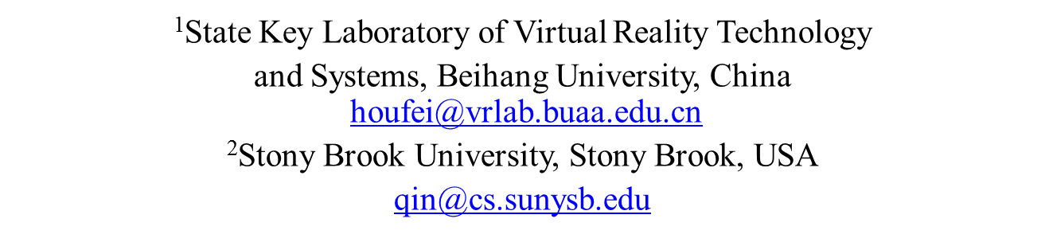
Thank You and Questions
This work is supported by National Natural Science Foundation of China (No.61190120, No.61190125, 61190124) and NSF (IIS-0949467, IIS-1047715).
Efﬁcient 3D Reconstruction of Vessels from Multi-views of X-Ray Angiography
Xinglong Liu¹, Fei Hou¹, Aimin Hao¹, Hong Qin²
Notes:
Thank You!

